Slide 1
ES6 – ESNext –Es2015
New features : new functionalities over ES5 : es2009
Block Scoping using let and const
String Literals : `` plus ${}
Arrow Function
Default Values For Parameters
---------------------------------------------
Classes : members private , public , inheritance using extends
Modules
Promises : Async And Await keywords

Slide 2
ES5: No Block Scoping :
In Es5 : Global Scope , Local Scope : Function Scope
In Es5 : no block scoping
In Es5: if(1<5)
{
var x = 10; // it not means that x can only accessible inside if scope
}

Slide 3
Variables Declared using var : variable is hoisting : ترقيه
<script>
console.log(x);// read x value from memory : expected Error :
// actual result : x = undefined | c.l(x+10)=> NaN
var x=10; // declaration plus assign
console.log(x);// 10
</script>
Hoisting Section : var x; // undefined | undefined

Slide 4
Functions :
Any function in js : will return even if you don’t write return explicit
function myfun(){
return 5;
}
function myfun2(){
// return undefined
}
ES5:
1- function statement : hoisted totally
Start definition for function using function
Function name required
Sum();
Ex: function Sum(){
}
function(){
}
ES5:
1- function expression:
Start definition for function using variable not function keyword
var Sum= function(){
}
Function name is optional
Sum()
- Used with object
Var person={
print:function(){
}
}
Person.print();

Slide 5
No overload in js
function Sum(a,b){
return a+b;
}
function Sum(a,b,c){
return a+b+c;
}
Only Copy Of Sum : Latest One : Sum(a,b,c)

Slide 6
let , const : Block Scope : not hoisted (you can’t deal with variables which declared using let and const before line of declaration)

Slide 7
don’t Use var any more : use only let or const for variable declaration

Slide 8
String Interpoation : ذ`` => backticks not single quotes ‘’
Backticks used to respresent strings in easy way than quotes : single or double
Let mystr = “My Name is Nasr ”;

Slide 9
Default Values For Arguments

Slide 10
Arrow Function , fat Arrow: lambda expression ()=>{}
Arrow Function Features :
1- not have this(mapping to outer scope this) and arguments
2- arrow must be declared as function expression
3- arrow function not hoisted
------------------------------------------------------------

Slide 11
… | spread , rest operator
… rest : if you write it in function declaration as arguments
… rest operator represent data in array object : : you can call all arrays methods with rest operator
You can’t write more than one rest operator for function declaration
Rest operator must be last parameter for function
function Sum(a,…others){
Return
}

Slide 12
… spread :
Let arrone=[10,20,30];
Let arrtwo=[1000,2000];
arrtwo=[1000,10,20,30,2000];
Arrtwo=[1000,arrone,2000]; : [1000,…arrone,2000];
[1000,10,20,30,2000];

Slide 13
Destructing
Detsructing for Array Objects
let myarr=[100,200,300,400];
let fnumber=myarr[0];
let snumber=myarr[1];
Destructing For Objects

Slide 14
Concise Method
Must be written inside object or class
const myobj={
ID:100,
Name:”Hamada”,
print:function(){
}
}
Must be written inside object or class
const myobj={
ID:100,
Name:”Hamada”,
print (){
// concise method
}
}

Slide 15
Classes
In ES5: we don’t have keyword class : to create class in ES5 we use constructor function
In Es6: Class Keyword Added , We Can use it to create , support inheritance ,…

Slide 16
Classes features
1- classes not hoisted : you can create an object from class after class declaration )
2- fields inside class we can define it as public using keyword this , or private using #
3- you can create set of properties inside classes to set or get values for fields
4- function inside classes will be defined as concise methods
5- you can declare static members inside class using static keyword
6- you can inehrite class from another class using extends keyword

Slide 17
Multiple Inheritance :
Not allowed in js
Class Person{
id
name
print
}
Class Employee{
id
name
salary
print
}
Inheritance : Extend functionality
Person : parent class , super , base
Employee : Child Class , derived
A
B
A
To inherit from class : use keyword : extends
After class name for child class
In js : available multi level of inheritance
B
C
C
D

Slide 18
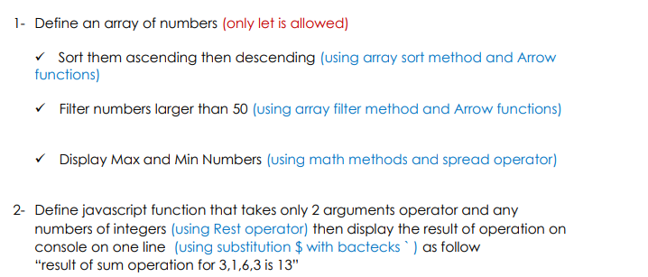
Lab

